Slide 1

Hands on Computer Vision
Hand Gesture Detection
MHA
Mohammad Hssein Alizadeh
info@mohammad-hossein.ir
Source: computervision.zone

Slide 2
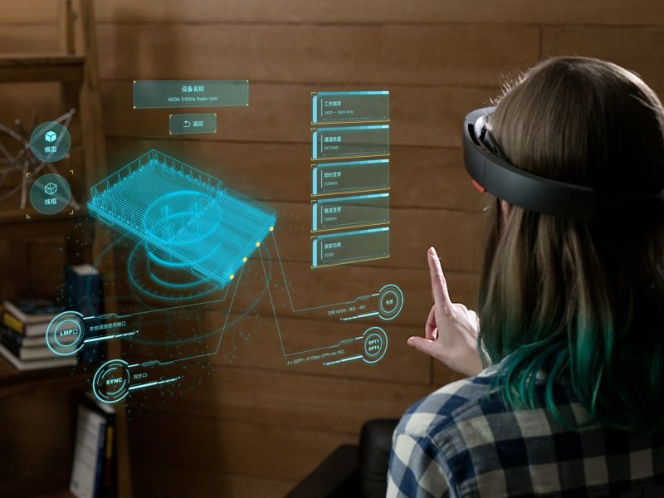
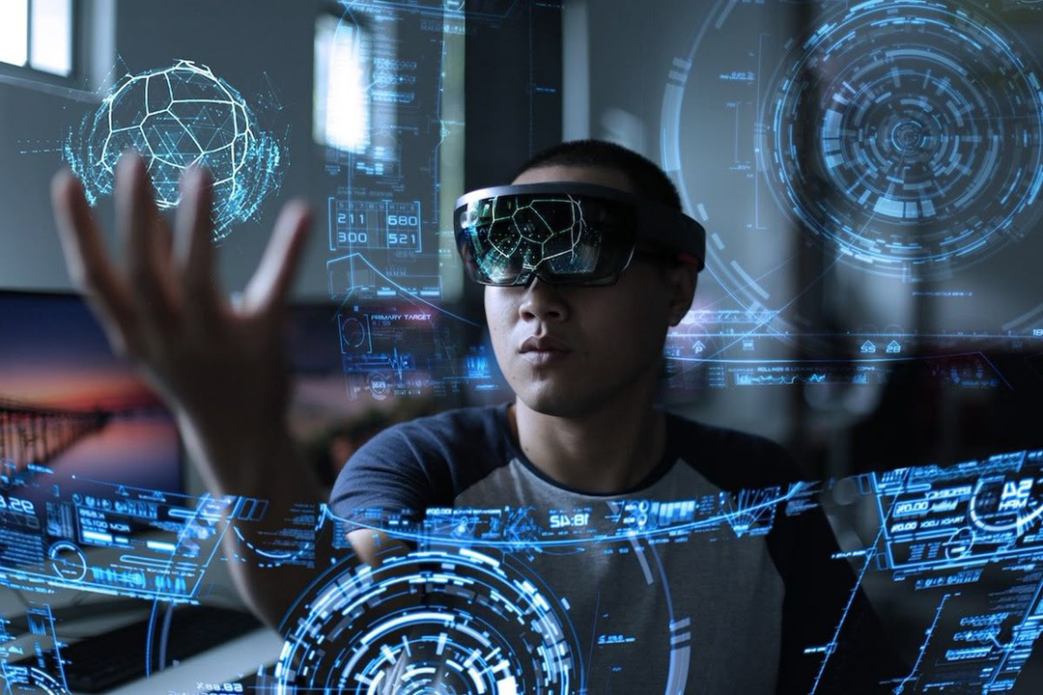
Idea
MHA

Slide 3
Prerequisite
MHA
Minimum knowledge of Python

Slide 4
MHA
...STOP!!

Slide 5


MediaPipe
MHA
chuoling.github.io/mediapipe

Slide 6
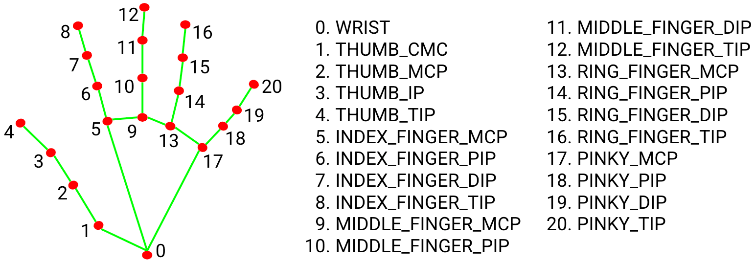
Hand Landmarks
MHA

Slide 7


Source Code
MHA
https://github.com/alizadeh-ai
https://t.me/mha_me => @mha_me

Slide 8

OpenCV
MHA

Slide 9
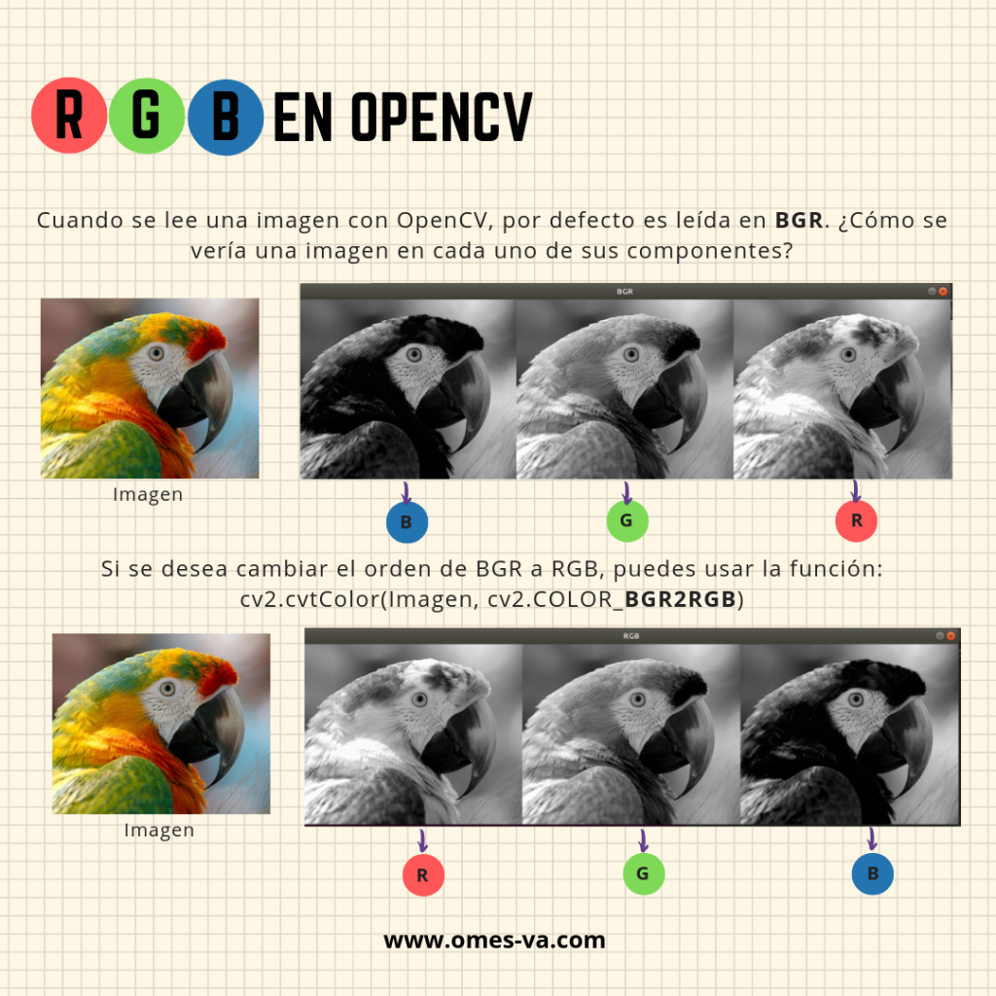
OpenCV
MHA

Slide 10
MHA
Thanks :)
Mohammad Hssein Alizadeh
info@mohammad-hossein.ir

